Slide 1
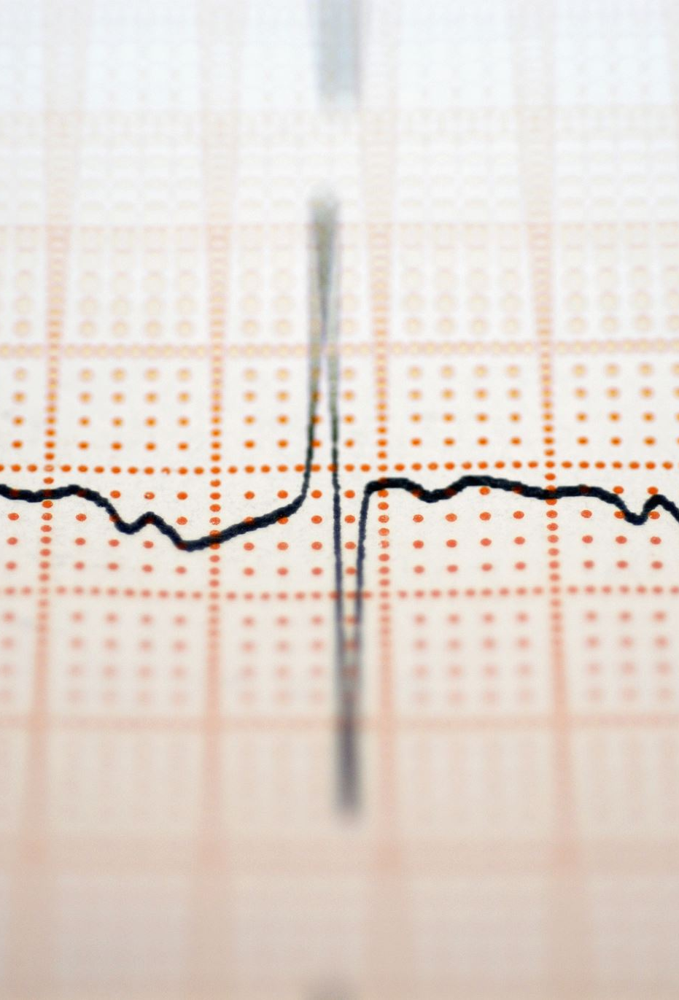
SARS COVID-19 DETECTION THROUGH AI CS-691

Slide 2

agenda

Slide 3
Techniques for Detecting SARS-CoV-2: A Brief Overview
Conventional techniques for detecting SARS-CoV-2 include reverse transcription polymerase chain reaction (RT-PCR) and antigen testing.
Advantages of AI in SARS-CoV-2 Detection and Prevention Review of AI Methods for SARS-CoV-2 Detection and Prevention
Outline of artificial intelligence (AI) approaches used to identify SARS-CoV-2 (e.g., machine learning, deep learning); AI's benefits and drawbacks; Examples of effective AI applications for SARS-CoV-2 detection;
Data limits, potential sources of data, and methods for overcoming data restrictions are discussed in the following sections: •Data Collecting and Preprocessing•Overview of data needs for AI-based SARS-CoV-2 detection•Challenges in collecting and preparing SARS-CoV-2 data.

Slide 4

Improvements made by professor feedback

Slide 5
1. Team velocity chart
2.burn chart
3.user-stories

Slide 6

Project description

Slide 7
To create and verify AI models for SARS-CoV-2 viral identification in patient samples is the goal of the SARS-CoV-2 Detection using AI project.
In order to create effective and efficient virus detection models, the project will investigate several artificial intelligence approaches such as deep learning or machine learning.

Slide 8
Team members

Slide 9
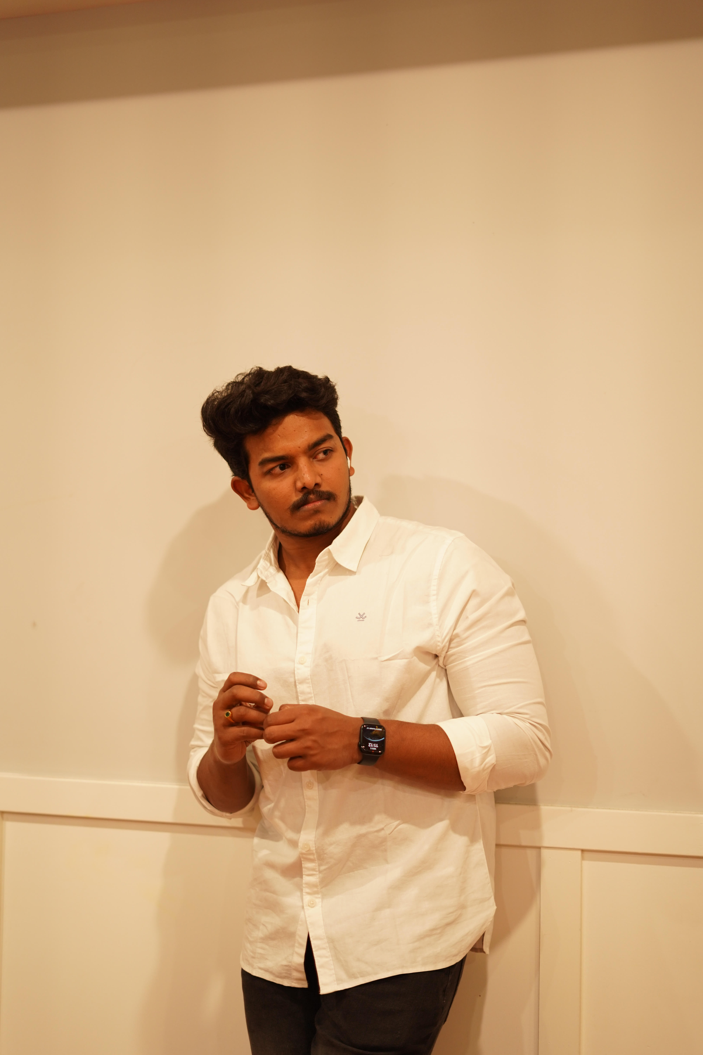


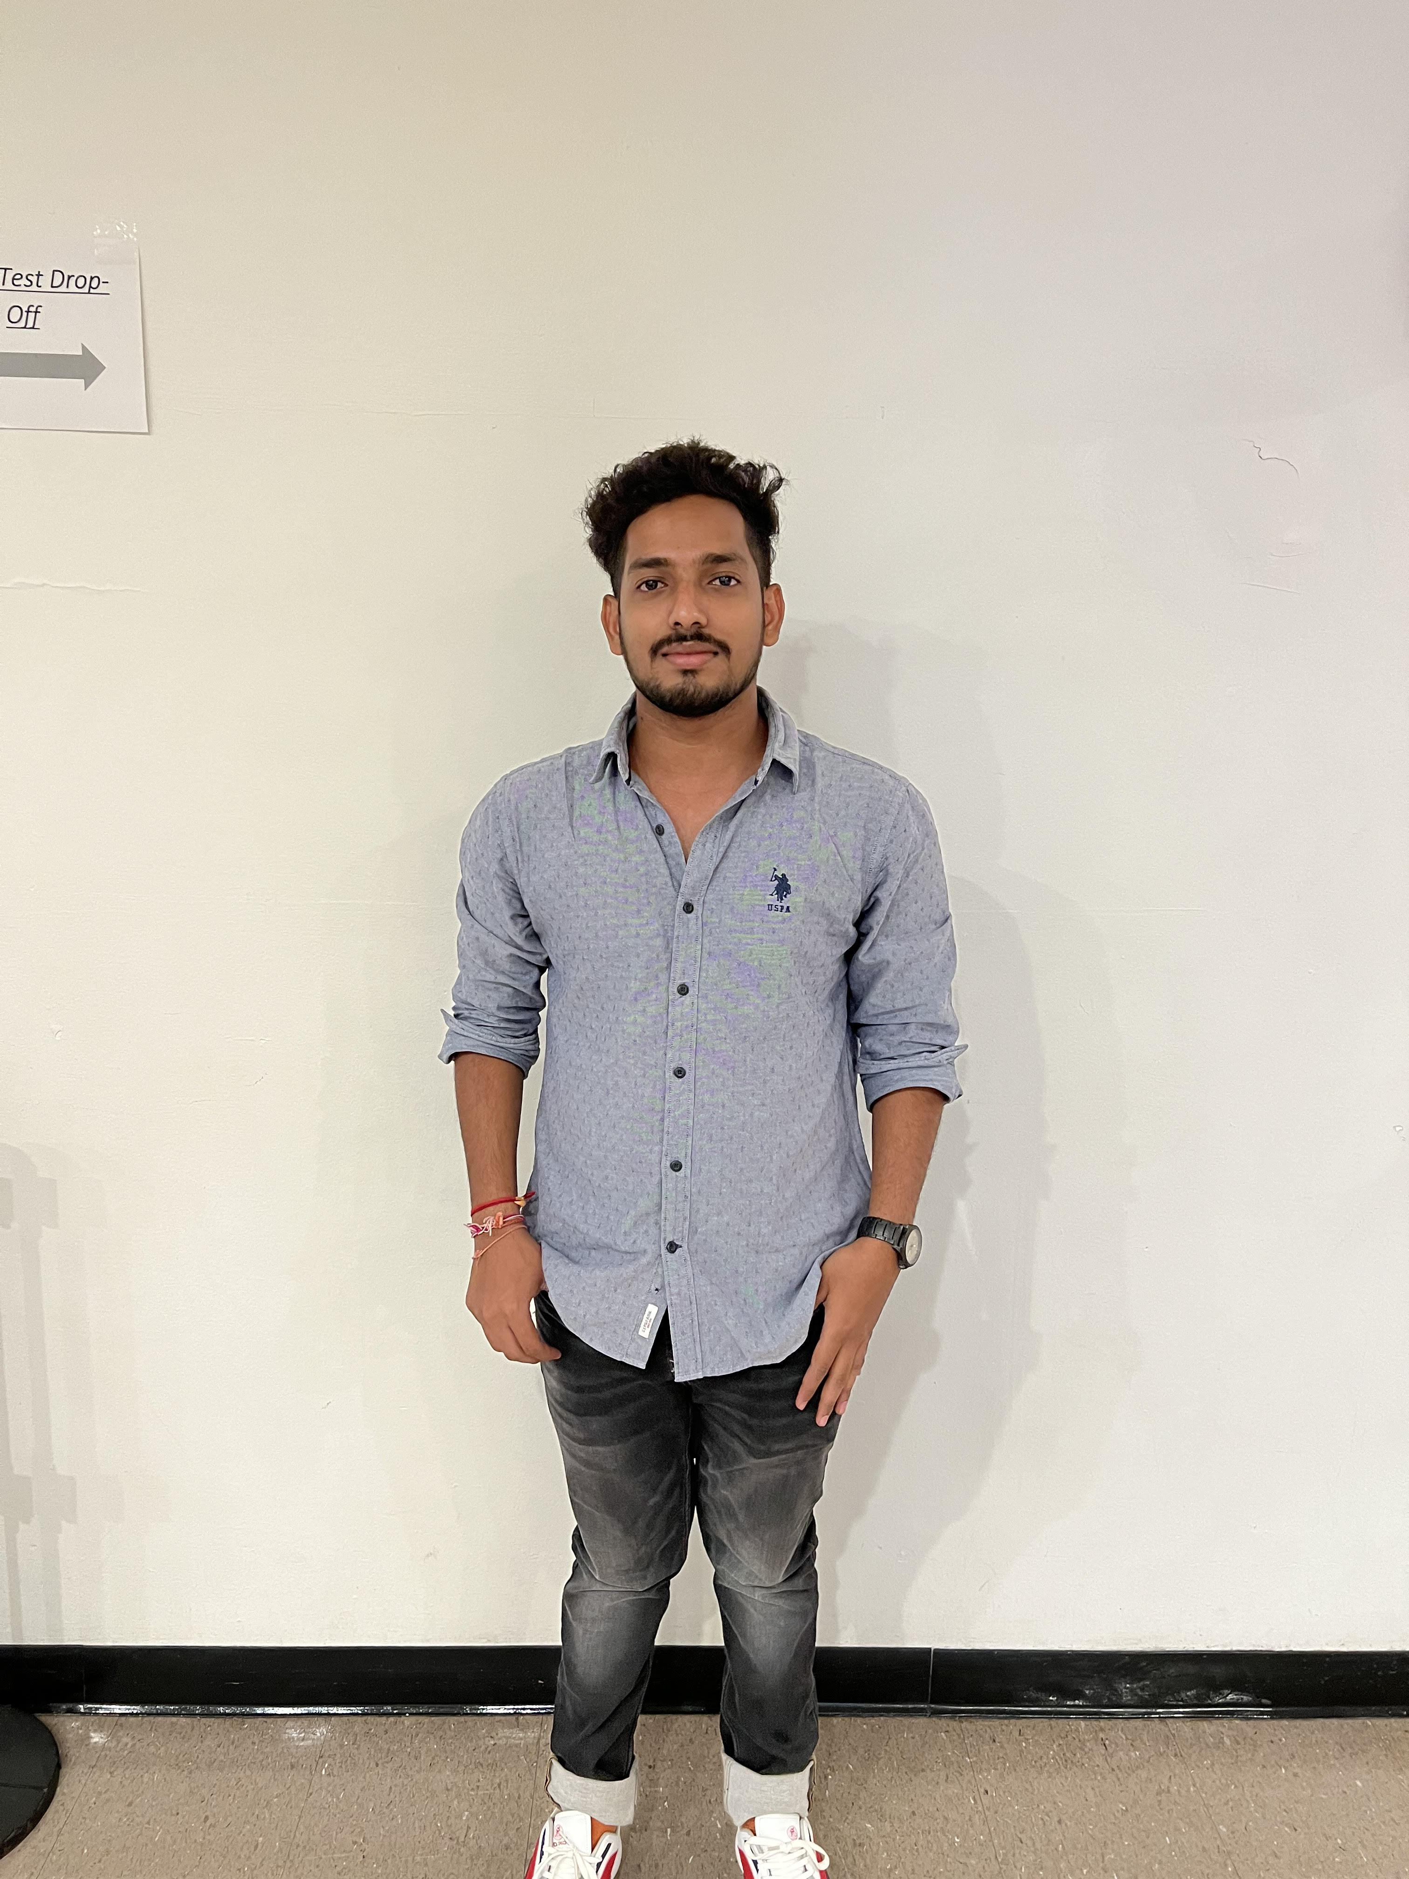


Anusha
Reshma
Venkatesh
Hanith
Vamsi
alekhya

Slide 10
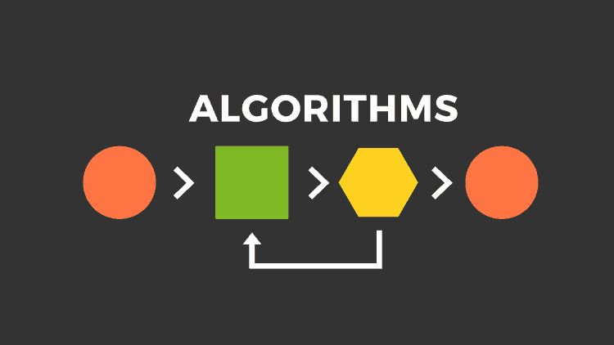

Slide 11
1. Linear Regression:
Linear regression is a statistical algorithm used to analyze the relationship between two or more variables. It finds a linear relationship between a dependent variable and one or more independent variables. Linear regression can be used to analyze the relationship between various factors and the number of COVID-19 cases in a particular region. By using historical data, the algorithm can predict the spread of the virus in the future.
2. Logistic Regression:
Logistic regression is a statistical algorithm used to predict the probability of a binary outcome based on one or more predictor variables. Logistic regression can be used to predict the probability of an individual getting infected with COVID-19 based on their age, sex, underlying health conditions, and other factors. The algorithm can be trained using historical data to identify the risk factors associated with COVID-19.

Slide 12
3. Decision Tree:
A decision tree is a type of machine learning algorithm used for classification and regression analysis. It is a tree-like model where each internal node represents a test on an attribute, each branch represents the outcome of the test, and each leaf node represents a class label. Decision tree can be used to classify individuals as either infected or not infected with COVID-19 based on various factors such as their age, sex, symptoms, and exposure to the virus. The algorithm can help identify the most significant factors that contribute to the spread of the virus.
4. KNN Algorithm:
K-Nearest Neighbors (KNN) is a type of machine learning algorithm used for classification and regression analysis. It is a non-parametric algorithm that makes predictions based on the similarity between new data points and existing data points. KNN algorithm can be used to classify individuals as infected or not infected with COVID-19 based on their similarity to other individuals in a particular region. The algorithm can help identify clusters of infected individuals and predict the spread of the virus.

Slide 13
5. Tensorflow:
Tensorflow is an open-source machine learning framework developed by Google. It can be used to develop machine learning models to detect COVID-19 using data from various sources such as X-ray images, CT scans, and other medical imaging techniques. The algorithm can be trained using a large dataset of images to recognize patterns associated with COVID-19.
6. Deep Learning Classification:
Deep learning classification algorithms are a type of machine learning algorithm that use neural networks to recognize patterns in large datasets. They are used to analyze medical images such as X-rays and CT scans to detect signs of COVID-19. The algorithm can be trained using a large dataset of images to recognize patterns associated with COVID-19.

Slide 14
7. Image Recognition:
Image recognition algorithms are used to analyze medical images such as X-rays and CT scans to detect signs of COVID-19. The algorithm can be trained using a large dataset of images to recognize patterns associated with COVID-19.
8. Pattern Recognition:
Pattern recognition algorithms are used to analyze various factors such as symptoms, age, sex, and exposure to the virus to identify patterns associated with COVID-19. The algorithm can help predict the spread of the virus and identify risk factors associated with COVID-19.

Slide 15
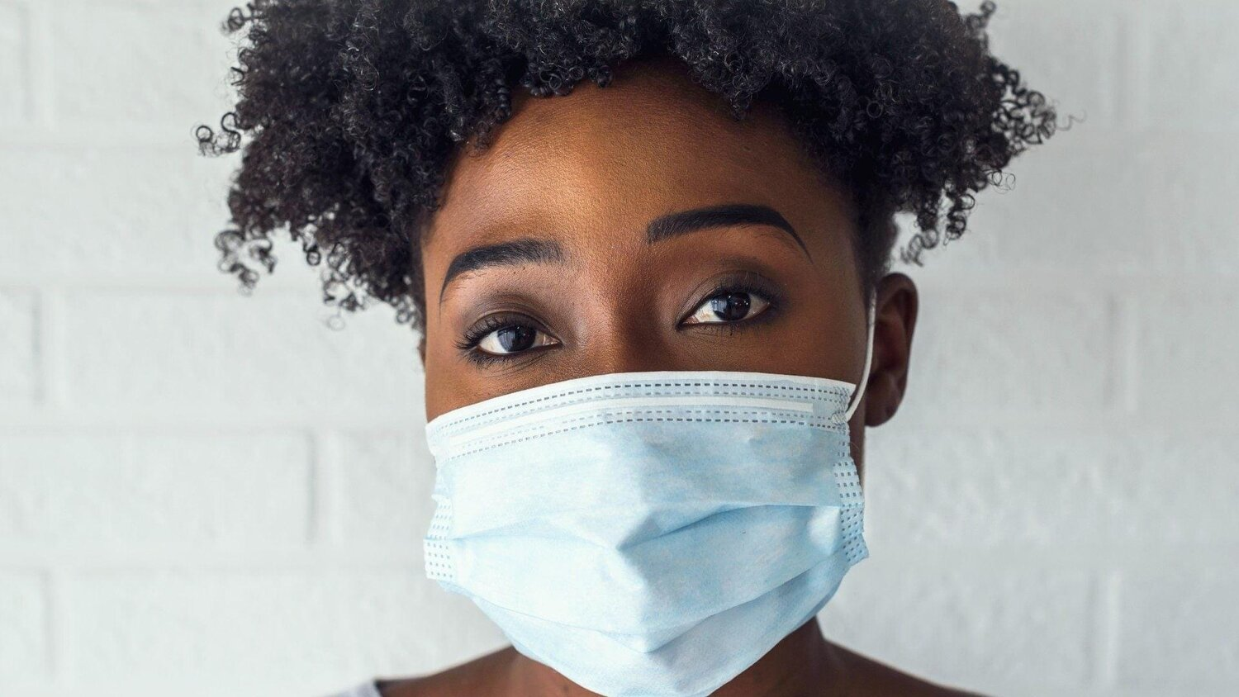
PERSONAS
ALENA WILLIAMS
AGE :- 32 YEARS
GENDER:- FEMALE
SHE IS UNSURE ABOUT THE COVID 19.SHE REALLY WANT TO TEST HER OWN ABILITIES.SHE CAN ORDER TESTING KITS BY UTILIZING SARS COVID 19
DETECTION VIA ARTIFICIAL INTELLIGENCE. BECAUSE OF HER CHILDREN, SHE IS UNABLE TO RELIABLY APPROACH HER INFANT CHILD WHEN HE OR SHE IS EXPERIENCING SYMPTOMS.

Slide 16
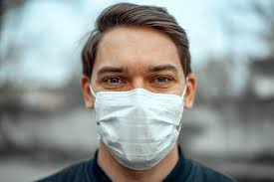
CHARLES JOHN
AGE :- 23 YEARS
GENDER:- MALE
HE WENT TO THE HOSPITAL TO GET WEIGHED OUT BECAUSE HE HADN'T BEEN FEELING VERY WELL, AND THE DOCTORS THERE LOOKED FOR SIGNS OF CONVULSIONS IN HIM.
HE IS CONFINED TO THE HOUSE AND UNABLE TO GO ANYWHERE ELSE BECAUSE OF THE SIDE EFFECTS OF COVID-19. HE IS ABLE TO DISCUSS HER HUSBAND'S ILLNESS WITH A CHATBOT THAT EMPLOYS SARS COVID- 19 DETECTION UTILIZING AI, AND IN RETURN, SHE WILL OBTAIN ADVICE FROM TRAINED MEDICAL SPECIALISTS

Slide 17
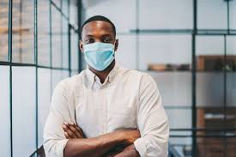
JIMMY ANDERSON
AGE :- 28 YEARS
GENDER:- MALE
HE WENT TO THE HOSPITAL TO GET CHECKED OUT SINCE HE WASN'T FEELING VERY WELL, AND THE DOCTORS WANTED TO SEE WHETHER HE WAS SHOWING ANY SIGNS OF CONVULSIONS.
THE CT SCAN WAS CARRIED OUT, AND THE FINDINGS WERE GATHERED. YET, NONE OF THE DOCTORS ARE AVAILABLE TO TALK ABOUT THE PAPERS AND PROVIDE THEIR FEEDBACK. HE IS ABLE TO INPUT THE REPORT INTO THE PROGRAM AND OBTAIN THE FINDINGS BY MAKING USE OF THE SARS COVID-19 DETECTION WITH AI TECHNOLOGY

Slide 18
MVP(Minimum Viable Product)
REGISTRATION (SIGN UP AND LOG IN )
SCHEDULED CONFIRMATION
UNIQUE ACCOUNT
T OOL KITS
HOME PAGE
MEDICINES
SERVICES
HEALTH TRACKING
PRECAUTIONS
DIET
APPOINTMENT WITH DOCTOR
MEDICAL ALARM

Slide 19








TECHNOLOGIES

Slide 20
TEAM AGREEMENT
There will be several ways for team members to communicate with one another.
This team will be using the zoom meetings once a week for productive team conversations.
There will be more partnership and visibility on the team if everyone keeps their straight faces.
A Whatsapp chat group or zoom meet will be utilized for any
last-minute questions or concerns, as well as for any other pressing matters.
Google Docs, Whatsapp, slack where all members of the team may work together to create a single document, will be used to distribute the final yields, and provide quality control.

Slide 21
The distribution of the work and levels of participation
Every member of the team should have about the same amount of
responsibility for the project, and the workload should be split proportionally.
Everyone on the team needs to get their task done on time
Their inability to meet deadlines will have a negative impact on the efficiency of the whole group. In the event that a squad member is having difficulty at any moment, they may let their teammates know so that they could still all pitch in to get things done on time.
It is anticipated that each member of the team would show up to the meetings in a timely manner.

Slide 22
Managing conflicts
Each member of the group would be in charge of coordinating the meeting's logistics and presiding over the gathering.
Each person in the group is responsible for contributing ideas, engaging in conversation, and reporting on the status of with there assigned tasks
Virtual weekly team meetings will take place on Zoom between Mondays and Wednesdays.Except perhaps in emergencies, engagement at team
meetings is required of all personnel..

Slide 23


Slide 24









Architecture Diagram
Business Layer
Frontend
Backend
Client
Amazon Route 53
Data Layer

Slide 25
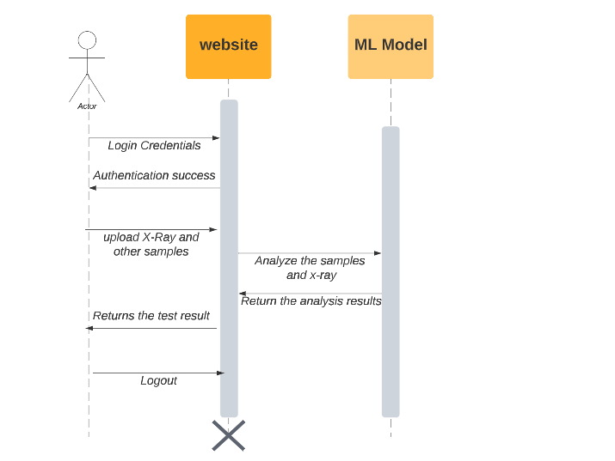
Sequence Diagram

Slide 26
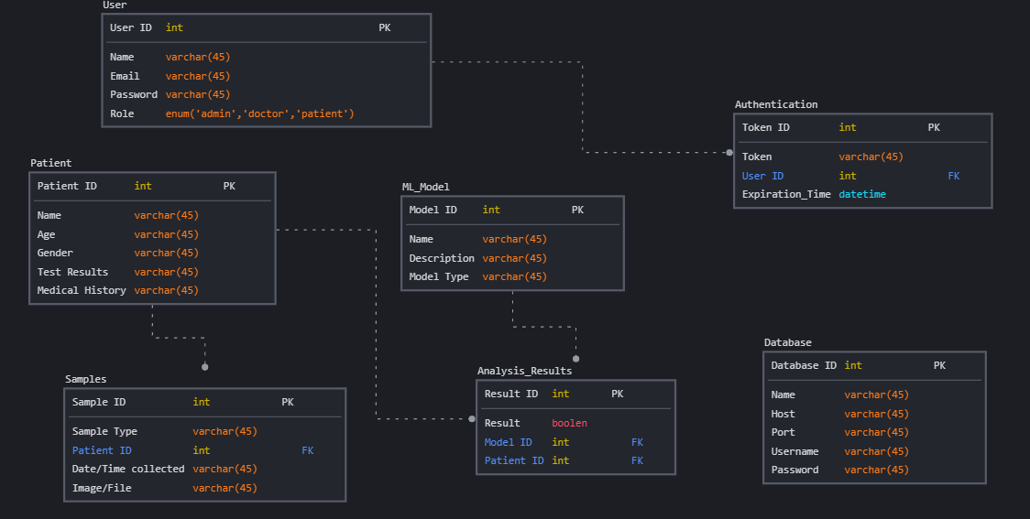
ER Diagram

Slide 27
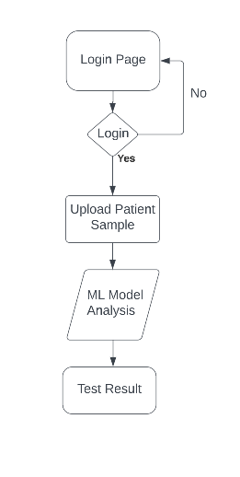

Slide 28
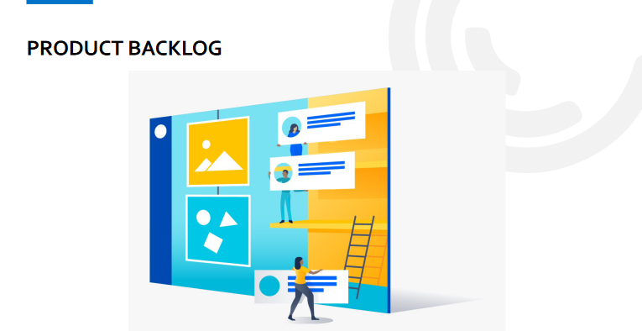

Slide 29
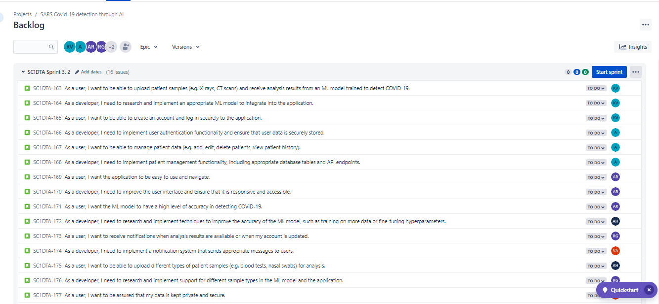

Slide 30
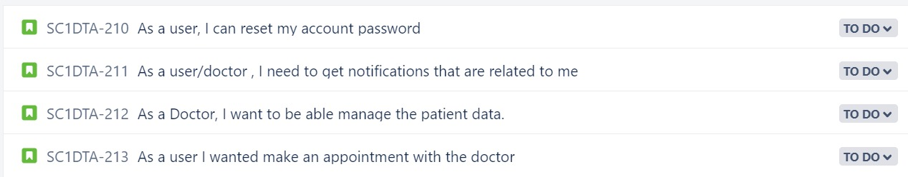
Sprint Backlog

Slide 31

User Stories
And
Acceptance Criteria

Slide 32
User Stories & Acceptance Criteria
ID | User Story | Acceptance criteria | Place
SC1DTA-210 | As a user I need to login into the portal to access all the benefits | When user tried to login into the portal, they need to be validated and redirected to the next page | Login
SC1DTA-211 | As a user I wanted to provide feedback to the doctor based on his service provided | When user wanted to provide feedback to the doctor, he can able to navigate to web page and provide his feedback to the selected doctor of his wish | Feedback
SC1DTA-212 | As a user/doctor , I need to get notifications that are related to me | Whenever an event happened , like login , forget password, results upload etc.. The user should get a notification on the registred email | Notifications/Remainders
SC1DTA-213 | As a user, I can reset my account password | As a user, I Can request to reset my password and an email to be trigerred to registred email | profile
SC1DTA-214 | As a Doctor, I want to be able manage the patient data. | As a doctor, I can view and correct the patient medical data as required to keep patient updated about his health status | Management

Slide 33
User Stories & Acceptance Criteria
ID | User Story | Acceptance criteria | Place
SC1DTA-215 | As a user I wanted make an appointment with the doctor | As a user, I can able to access doctors calender and make an appointment as required | Appointments
SC1DTA-216 | As a doctor I can see all the appoinments avaialble for the day | As a doctor, I Can able to view all the appoinments booked for the day and take them. | Appointments
SC1DTA-217 | As a admin, I need to send a remainder to the user about his appointment with doctor | As a admin, I need to trigger a continous notification to the user about his appointment with a doctor at specified intervals | Admin
SC1DTA-218 | As a admin, I need to send a remainder to the doctor about his appointment with user | As a admin, I need to trigger a continous notification to the doctor about his appointment with a user at specified intervals | Admin
SC1DTA-219 | As a user, I Can update my profile | User can able to update his profile details when required and need to be verified | profile

Slide 34

Test Cases
Tweaked after hearing from professors

Slide 35
Test Cases
Test Id | User story Id | Test Case | Current state | Test Data | steps to follow | Expected Result | Result
TS-31 | SC1DTA-210 | browse login page | User trying to log into the portal | user details( Login details) | login | users should get a new page where he can enter his login credentials | Pass
TS-32 | SC1DTA-210 | click on login | User trying to log into the portal | user details( Login details) | login | User credentials should be validated and return response | Pass
TS-33 | SC1DTA-212 | As a user, I need to recieve Notifications | User logged into the portal | User details | login | whenever I have logged into the portal I need to receive an email regarding this activity | Pass
TS-34 | SC1DTA-211 | provide feedback to the doctor | User logged into the portal | user details( Login details) | login-> doctors-> feedback | user should able to get a page where he can provide his feedback to a doctor | Pass
TS-35 | SC1DTA-211 | submit feedback | User logged into the portal | user details( Login details) , Feedback | login-> doctors-> feedback-> submit | user should able to submit his feedback to a selected doctor | Pass
TS-36 | SC1DTA-212 | As a Doctor, I need to recieve Notification regarding my feedback | Doctor logged into the portal | Doctor details | login->Notifications | As a doctor, I need to get a new notification regardinf the feedback that I have received | Pass
TS-37 | SC1DTA-214 | Manage patient Data | Doctor logged into the portal | Doctor details . Patient details | login->patient->manage-data | As a doctor , I can update patient medical data | Pass
TS-38 | SC1DTA-214 | save patient data | Doctor logged into the portal | Doctor details, Patient details, data | login->patient->manage-data->save | As a doctor, I can able to save the data | Pass

Slide 36
Test Cases
Test Id | User story Id | Test Case | Current state | Test Data | steps to follow | Expected Result | Result
TS-39 | SC1DTA-213 | Request forget password | User/doctor logged into the portal | User details/Doctor details | forget-password | User/doctor should able to request to reset their password | Pass
TS-40 | SC1DTA-213 | User/Doctor should get a notification to reset password | User/doctor logged into the portal | User details/Doctor details | forget-password | user/doctor should get a email to reset his pasword | Pass
TS-41 | SC1DTA-215 | User can able to access doctors calender | User logged into the portal | User details/Doctor details | login-> doctor-> calender | User should able to view doctors calender | Pass
TS-42 | SC1DTA-215 | User can able to schedule an appointment with a doctor | User logged into the portal | User details/Doctor details, Appointment details | login-> doctor-> appointment | User should able to make an appointment with a doctor | Pass
TS-43 | SC1DTA-216 | Doctor can view his appointments | Doctor logged into the portal | Doctor logged into the portal | login->my appointments | doctor can able to check all his appointments blocked | Pass
TS-44 | SC1DTA-219 | update user profile | User logged into the portal | User details | login->my profile | User/Doctoe should able to browse a page where they can see their profile details | Pass
TS-45 | SC1DTA-219 | save user profile | User logged into the portal | User details | login->my profile-> save | User can able to save all the changes made to his profile | Pass
TS-46 | SC1DTA-217 | Send remainder to User about his Appointment | User logged into the portal | User details | login-> notifications | User should able to get remainder notification about his appointment | Pass
TS-47 | SC1DTA-218 | Send remainder to Doctor about his Appointment | Doctor logged into the portal | Doctor logged into the portal | login-> notifications | Doctor should able to get remainder notification about his appointment | Pass

Slide 37
Name | Status | Date
As a user, I can reset my account password | to-do | TBD
As a Doctor, I want to be able manage the patient data. | to-do | TBD
As a user I wanted make an appointment with the doctor | to-do | TBD
As a doctor I can see all the appoinments avaialble for the day | to-do | TBD
As a admin, I need to send a remainder to the user about his appointment with doctor | to-do | TBD
As a admin, I need to send a remainder to the doctor about his appointment with user | to-do | TBD
As a user, I Can update my profile | to-do | TBD
Stories Not completed

Slide 38


Slide 39
Recap of the problem statement: "How can a machine learning algorithm be used to detect COVID-19 virus in X-rays and other samples of patients?"
Brief overview of the benefits of using machine learning for COVID-19 detection, such as increased accuracy and faster diagnosis
Overview of the technological stack used in the project, including programming languages, frameworks, and tools
Discussion of the machine learning libraries used, such as Scikit-learn and TensorFlow
Overview of the website development tools, including Flask, HTML/CSS, and JavaScript
Overview of the needs and requirements of each persona, such as ease of use for the medical professional and patient, and accuracy and interpretability for the researcher
Summary of how the project aims to meet the needs of these personas through its design and development.
Overview of the sprint retrospective process, including how feedback was gathered and analyzed
Overview of the product backlogs

Slide 40
Stories Completed and Stories Not Completed
Name | Status | Date
As a user I want to login with an extra security like Authentication factor. So that I can secure my account. | Done | 4/08/2023
As a user I want to communicate more with chat bot to discuss more details about health condition. | Done | 4/09/2023
As a user I want to provide feedback for doctors. So that it will help others to gather information about doctors. | Done | 4/09/2023
In order to order the COVID-19 tool kit. I want to register as a user. | Done | 4/11/2023
Technical Paper | Done | 4/11/2023

Slide 41

Team Velocity

Slide 42
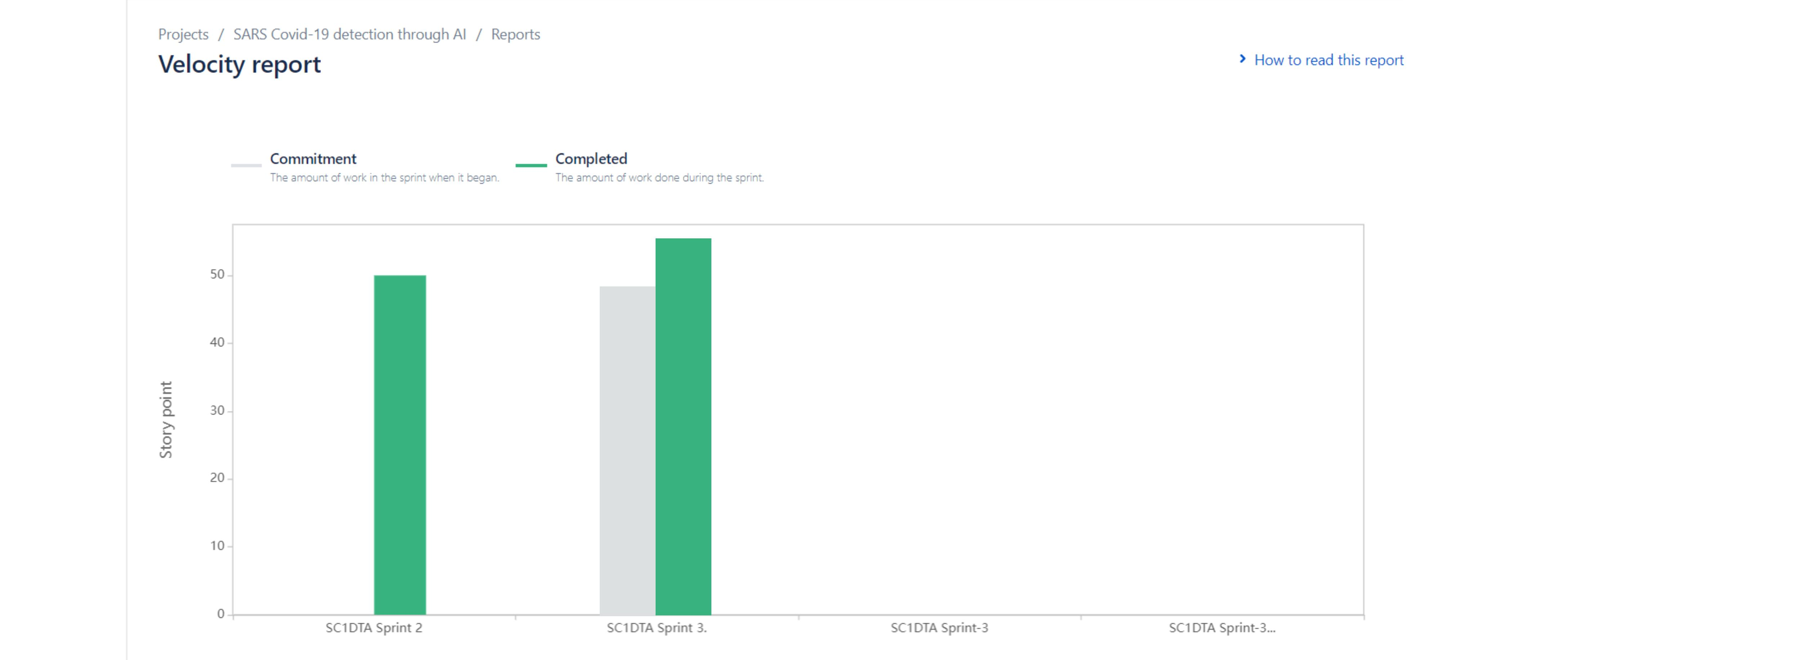
Team Velocity

Slide 43
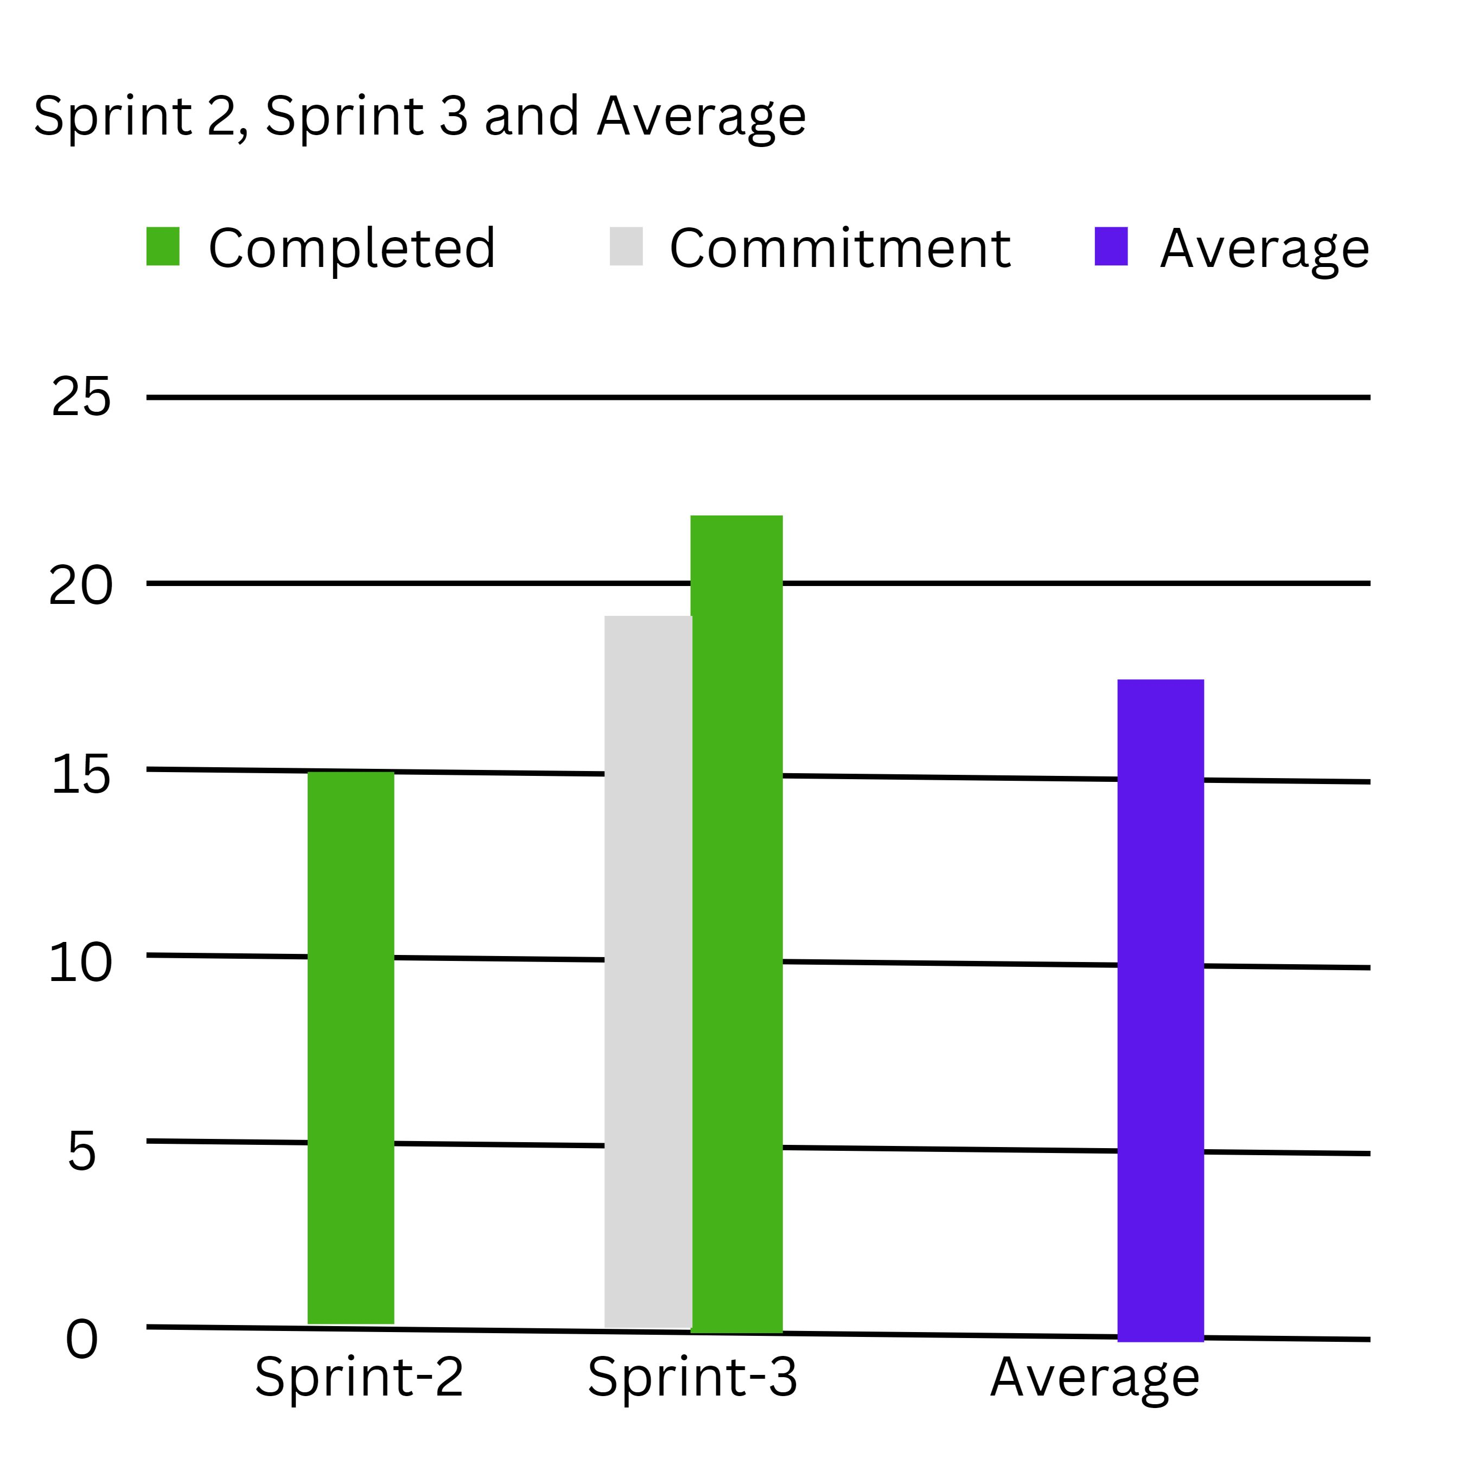
Team's historical velocity (average)
Tweaked after hearing from professors

Slide 44
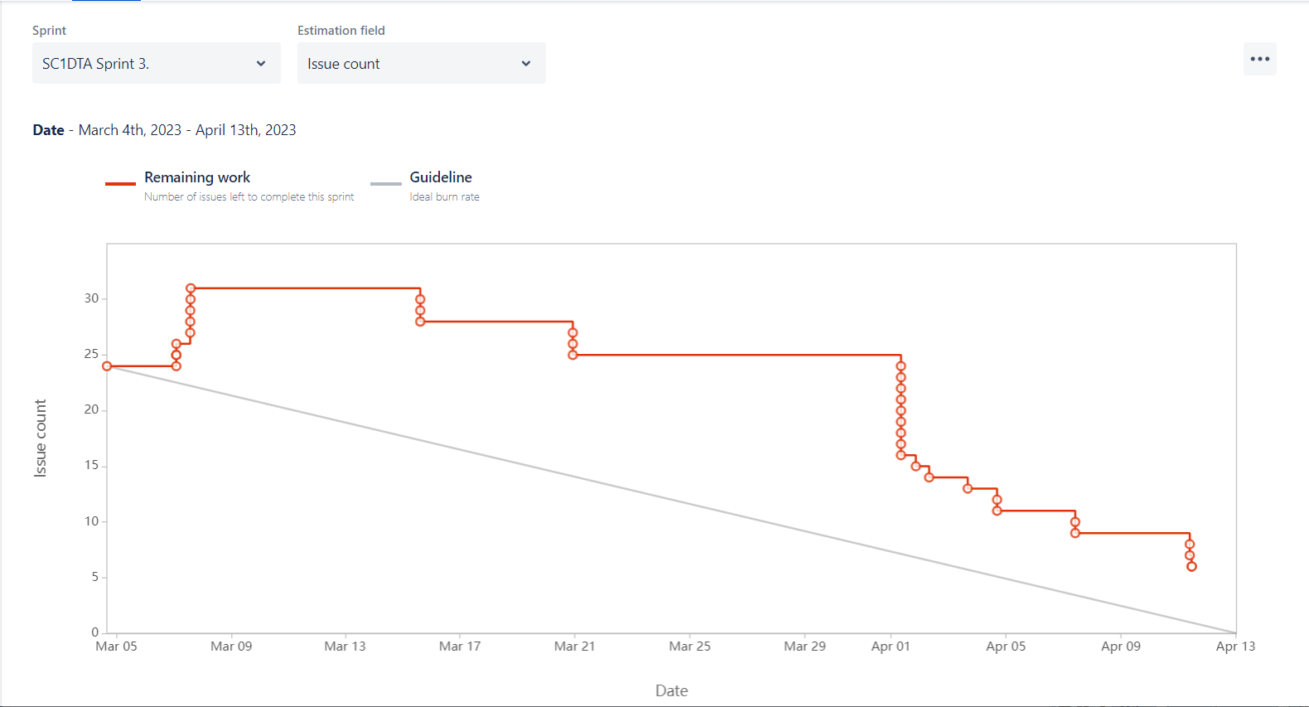
Burn down Charts
Tweaked after hearing from professors

Slide 45
Completed/Committed Ratio
The percentage of all tales delivered in a sprint that match the ones that were committed is known as the story completion ratio.
The story completion ratio for this team will be 96% since we commit 36 user stories in a sprint and deliver 34, as a result.
Story completion ratio is calculated as (total number of delivered stories / total number of committed stories) x 100.

Slide 46

Retrospective

Slide 47
What Went Well
Our deliverable was uploaded without any problems and on schedule. This time, we worked well together as well. Because we meet and talk more with all of our teammates.
We have talked about the work, and we clearly understand our responsibilities with regard to it.
We have a great time discussing the project further, and the time truly helps us to submit our work on schedule.
Every member of the group contributes ideas to the project.

Slide 48
What needs Improvement
This time, we have corrected the errors that we made in the last deliverable, on which the professor provided interpretation.
We have updated both the user stories and the acceptance critiria in a single slide, as the lecturer indicated in the lecture regarding the user stories and the acceptance criteria.
The Sprint burn-down chart, which we had reviewed at least once a day, was also updated this time.
This would make it simpler for us to stay on schedule and guarantee that all urgent tasks are completed on time.
We also determine the strengths and weaknesses of our team in regard to our work.

Slide 49
Action we take to improve
We must be more committed to the project's aim and purpose.
Any threats to the project's success must be identified, and counter measures must be developed.
To reduce our negative effects on the project, we must be proactive in controlling these risks.
The success of our project depends on having the appropriate people on my team.
Verified our team members have the abilities, dedication, and experience required to meet the project's objectives.
We take lessons from your successes and failures to improve your project delievrable procedures and techniques over time.

Slide 50
Sprint-4
Issue Type | Name | Status
Story | As a user, I want to be able to create an account and log in securely to the application. | To Do
Story | As a user, I want to be able manage the patient data. | To Do
Story | As a user, I want the application to be easy to use and navigate. | To Do
Story | As a user, I want to receive notifications when analysis results are available or when my account is updated. | To Do
Task | Technical Paper | To Do

Slide 51


